Slide 1
Microsoft Power Platform + Dynamics 365
Notes:
Hi, Welcome to Microsoft Power Platform + Dynamics 365 Bootcamp.

Slide 2
Course Overview
Day 1
Empowering Everyone with Power Platform – From CEO to Frontline Workers
Introduction to Power Platform
Day 2
Power Packed Day with Power Canvas Apps
Introduction to PowerApps
Day 3
Power Packed Day with Power Model Driven Apps
Let’s talk about data
Day 4
Power Packed Day with Power Automate
Introduction
Day 5
Power Packed Day with Power Virtual Agents
Introduction
Microsoft Power Platform momentum
Why Power Platform?
Customer Stories
Demo
Benefits of PowerApps
What can I build with PowerApps?
Types of PowerApps
Canvas Apps
Data Sources and Connectors
Demo
Types of Data
Common Data Service
Model-driven Apps
What type of components can I add?
Data model design
Demo
Types of flow
Data types and expression
Working with Arrays
Control flow and action settings
Demo
A Robust Virtual Agent Platform
Converse everywhere
Easily make your bots better
Create personalized customer experiences
Transfer to a human agent
Built on Power Platform & Azure Bot Service
Extend your bot capabilities with Azure Bot Service
Demo

Slide 3
Continue…
Day 6
Power Packed Day with Power BI
Introduction
Day 7
Power up your Apps with AI Builder
Introduction
Day 8
Power Platform Administration, Security & Integration Connectors
Introduction
Day 9
Power Packed Bizz Apps Day – Sales & Marketing
Introduction
Day 10
Power Packed Bizz Apps Day– Finance & Supply Chain
Introduction
AI for every app. And everyone
Setup Environment
Types of AI Model
Prediction
Form processing
Object detection
Text classification
Demo
The 5x5 Principle
Customer momentum: Power BI
Power BI Desktop
Data sources
Power Query
Dataflow
Using a Calculation (DAX) in multiple files
Paginated Reporting
Power BI Admin Portal
Demo
Secure your tenant
Monitor your tenant’s activity
Alert & act on that activity
Connectors
SharePoint Integration
Demo
Nurture more demand
Personalize buyer experiences
Build relationships at scale
Make insight-driven decisions
Demo
How to embed PowerApps in Dynamics 365 for Sales and Marketing
Technology Modernization
Modern Finance
Supporting modern supply chain management
Demo
How to embed Power Platform in Dynamics 365 for Finance and Supply Chain

Slide 4
Day 2: Power Packed Day with Power Canvas Apps

Slide 5

Agenda
Introduction to PowerApps
Benefits of PowerApps
What can I build with PowerApps?
Types of PowerApps
Canvas Apps
Data Sources and Connectors
Demo
Create the records in Dynamics CRM with the blank canvas app using Patch function

Slide 6
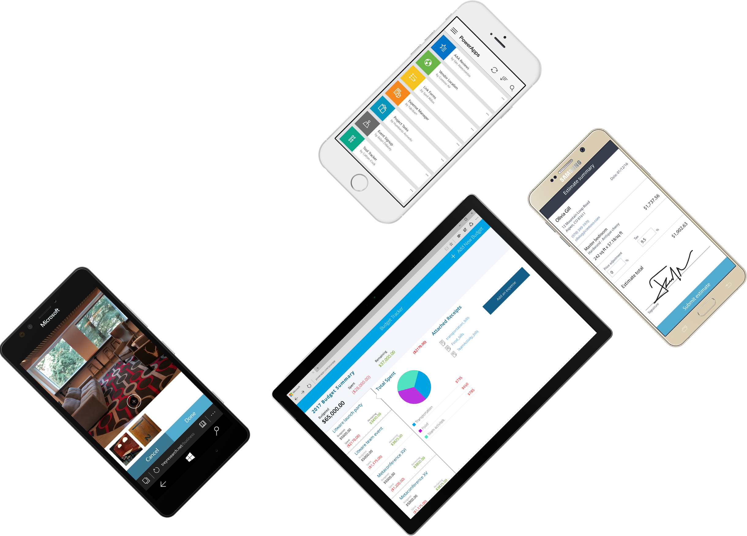
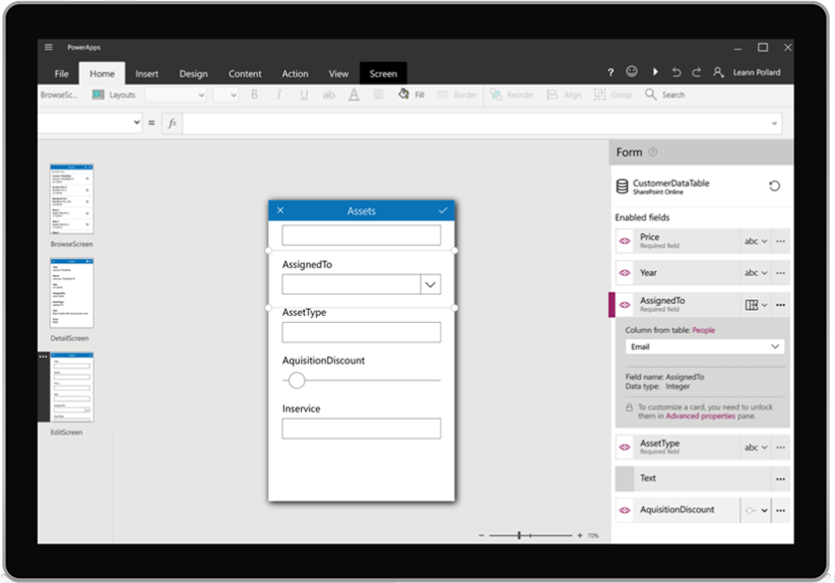
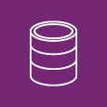
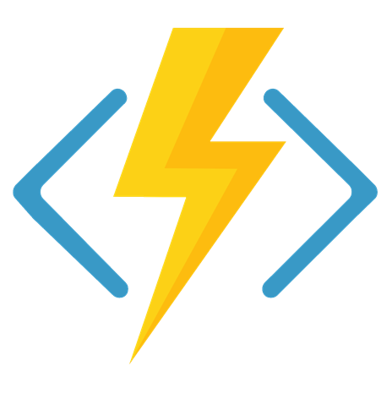




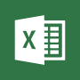







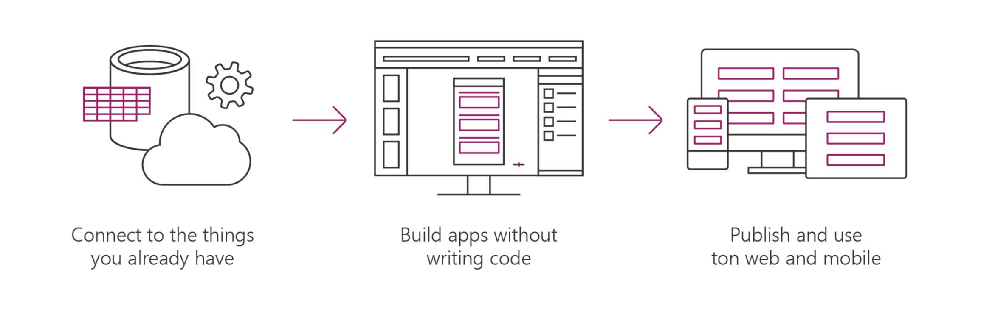




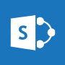






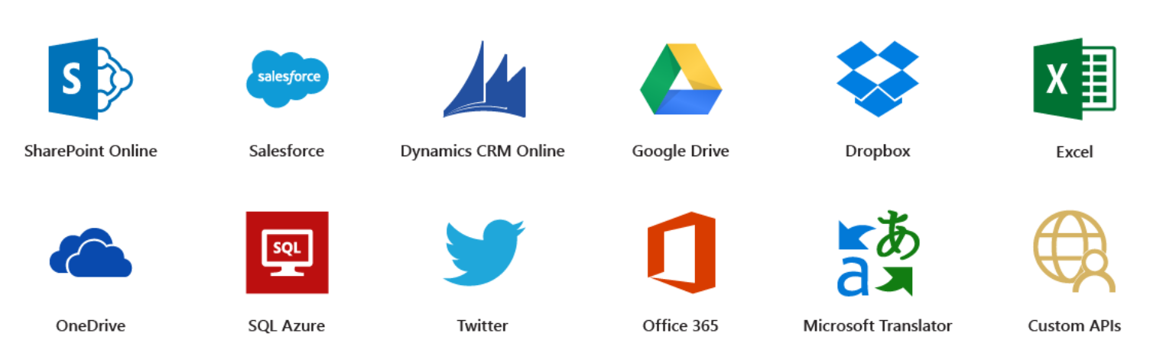




Microsoft PowerApps
Connect to existing systems and data sources
Common Data Platform
Azure Functions & REST services
Build apps, forms, and workflows without writing code
Publish apps instantly for web and mobile
Notes:
Microsoft PowerApps is a service for creating and using custom business apps across platforms

Slide 7
Benefits of PowerApps
Secure Scalable Managed Integrated Compliant
Fast Iterative
Cross-platform
Beautiful Easy

Slide 8
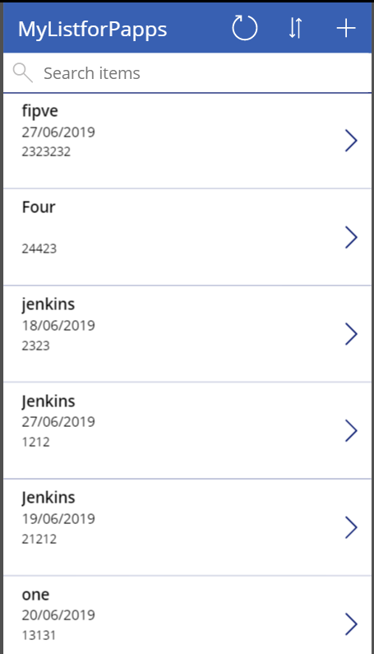
What can I build with PowerApps?
Apps based on data (SharePoint*, SQL, but also DropBox and Google Drive)
Onedimensional, form-based apps
Simple, single-task apps
Microphone, camera, GPS coordinates. Ink and pen support.
Multiple data sources in one app
Multiple screens

Slide 9
86% of the Fortune 500 are using Power Apps

Slide 10
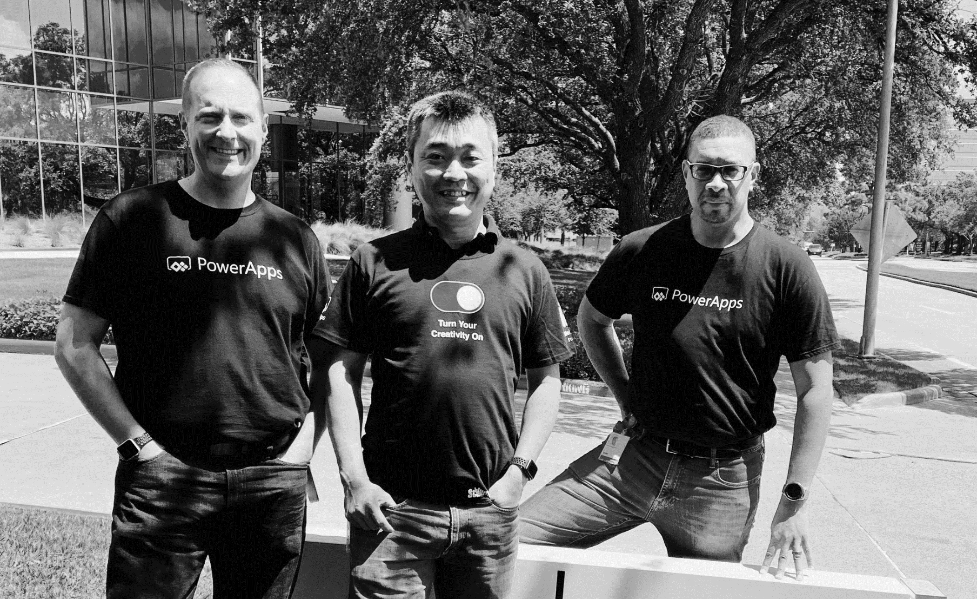
Pro dev
Citizen dev
IT admin
Empower every developer to do more.

Slide 11
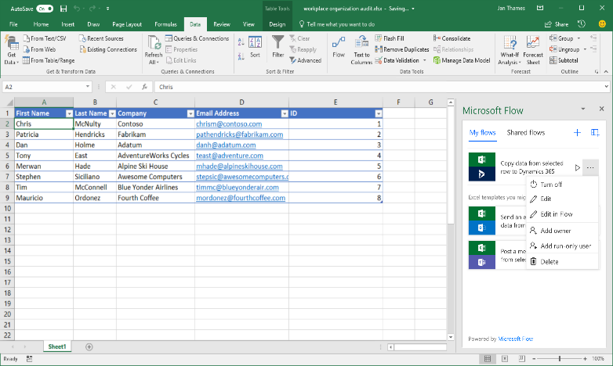
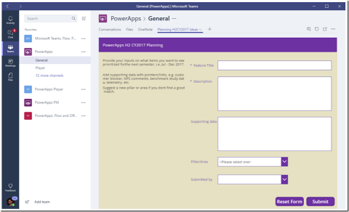
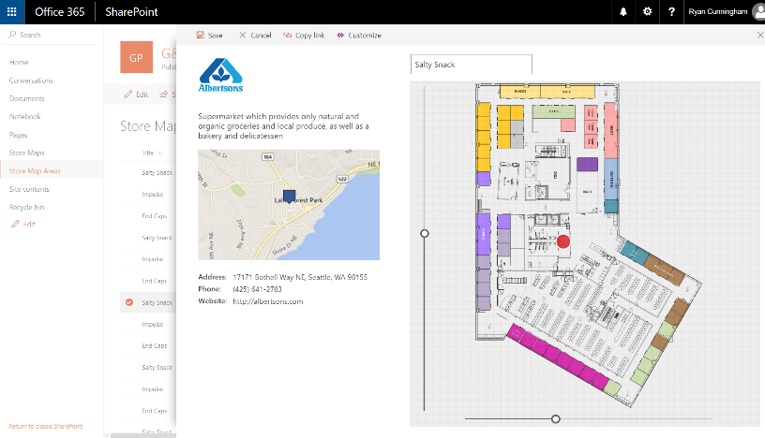
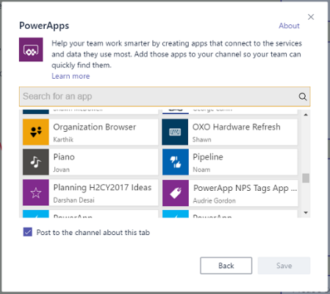
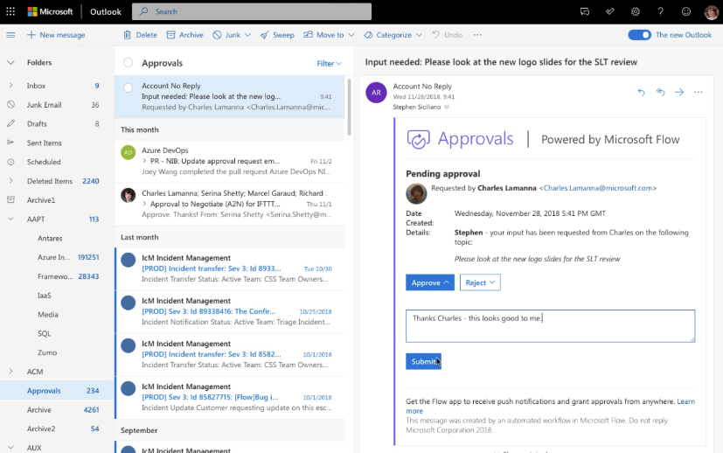
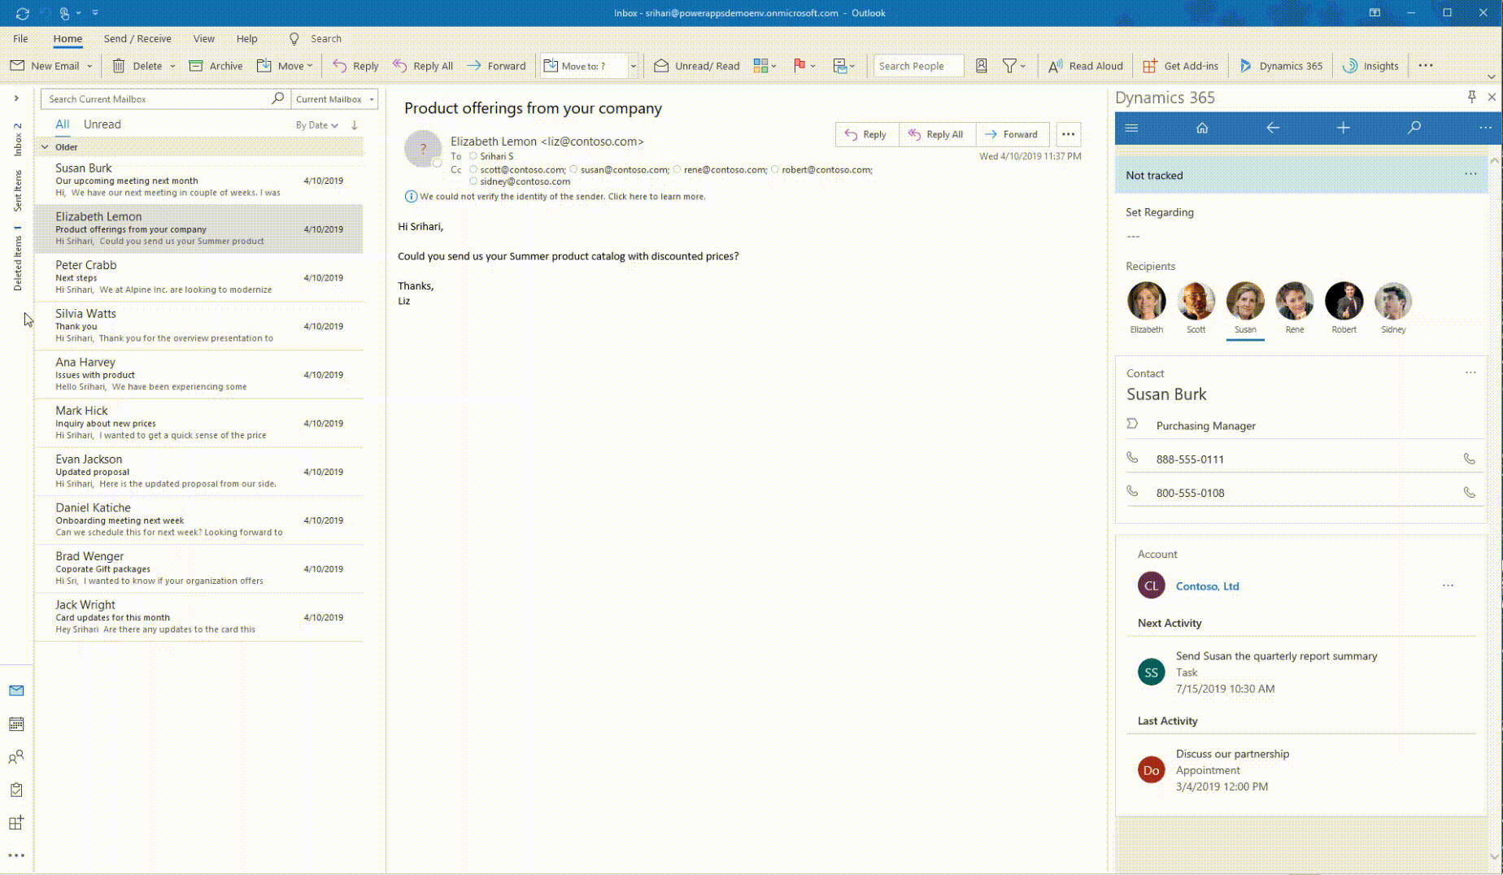
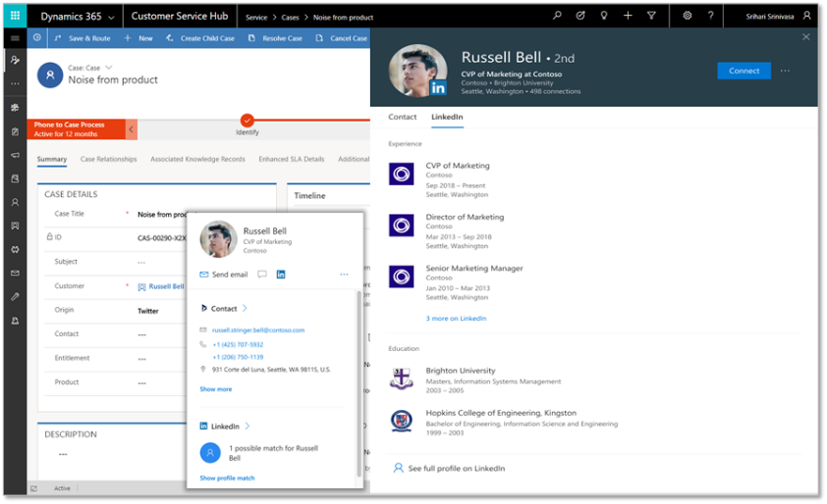
Deeply integrated with Microsoft 365
Customize the experience and automate SharePoint Lists with PowerApps and Flow
Build a PowerApp app from an Excel sheet or automate on an Excel sheet with Flow
Customize a tab with PowerApps, or automate a bot or process with Flow
Enhanced communication with Actionable Messages and Adaptive cards in Flow
Bring data from CDS and PowerApps UX to Outlook with the Mail App (WIn32, OWA and mobile)
Office 365 People Card in PowerApps + Dynamics (incl. LinkedIn info)

Slide 12

Why did we go with PowerApps
We needed a digital onboarding experience with a clear path for customers to follow in self-service planning of their Dynamics 365
Traditional web portals and custom apps are of course great if you know exactly what that path should look like
What we needed the most was the ability to experiment with the elements that should/shouldn’t be included in the onboarding path
Low-code/no-code approach of PowerApps canvas apps significantly lowers our need to commit to any specific feature or idea
Ability to delay developing any tailored UI or integration running on custom code, to the point when you know what you want to automate

Slide 13

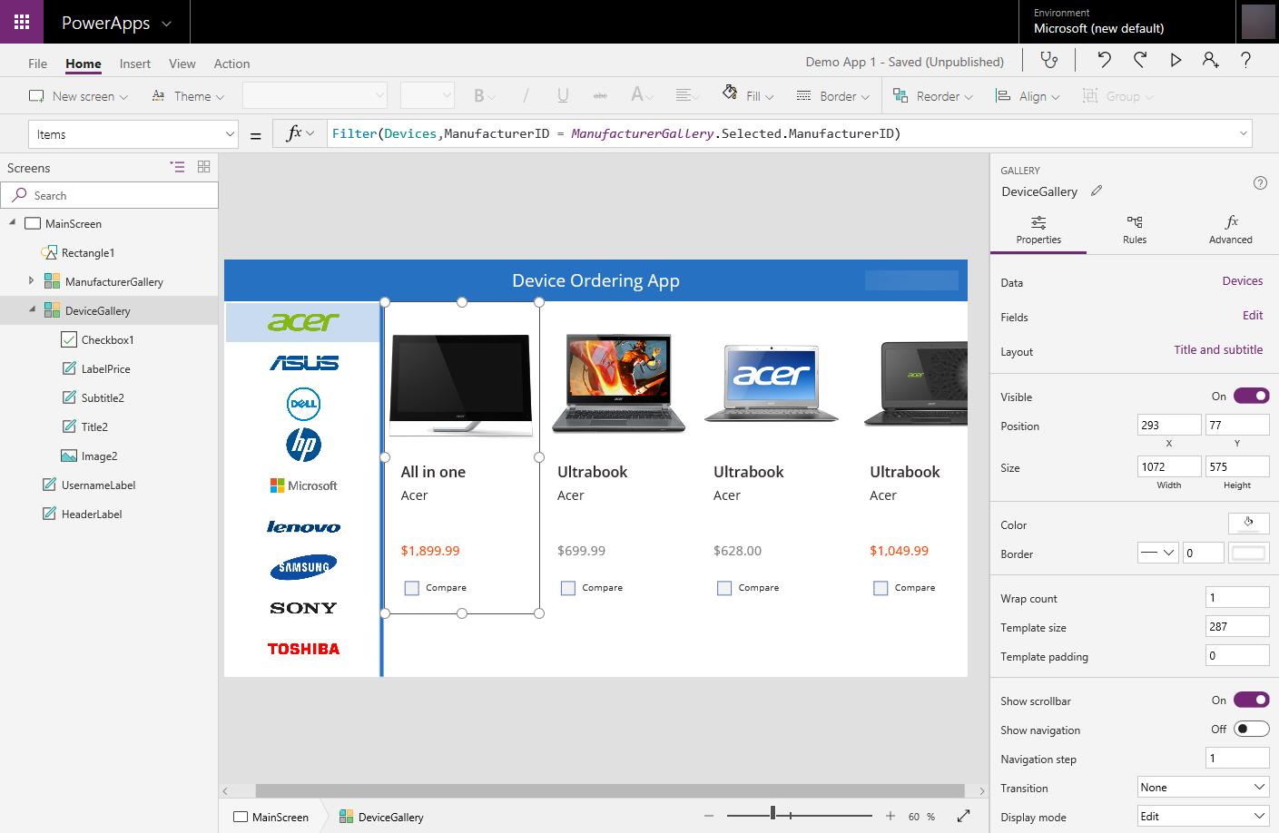


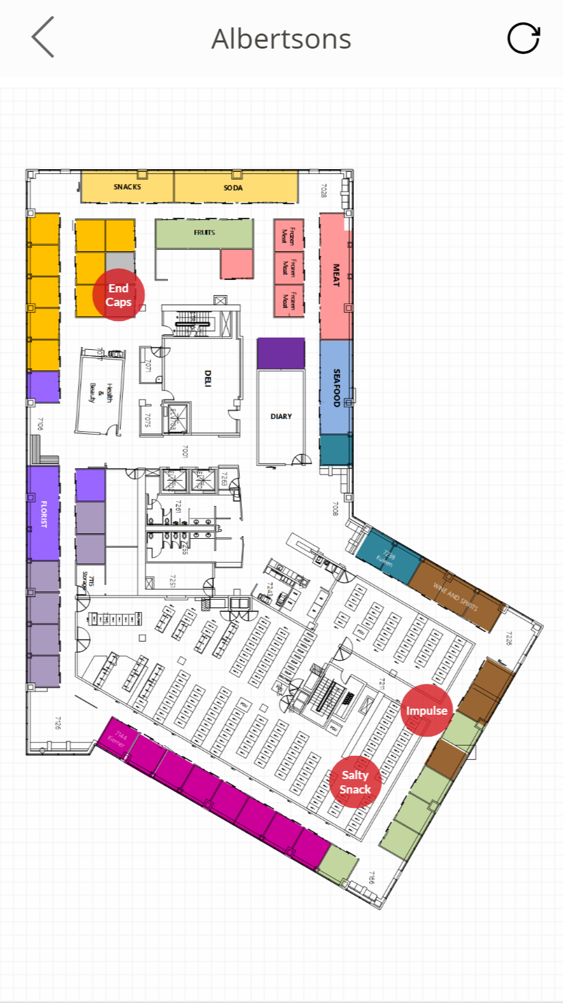
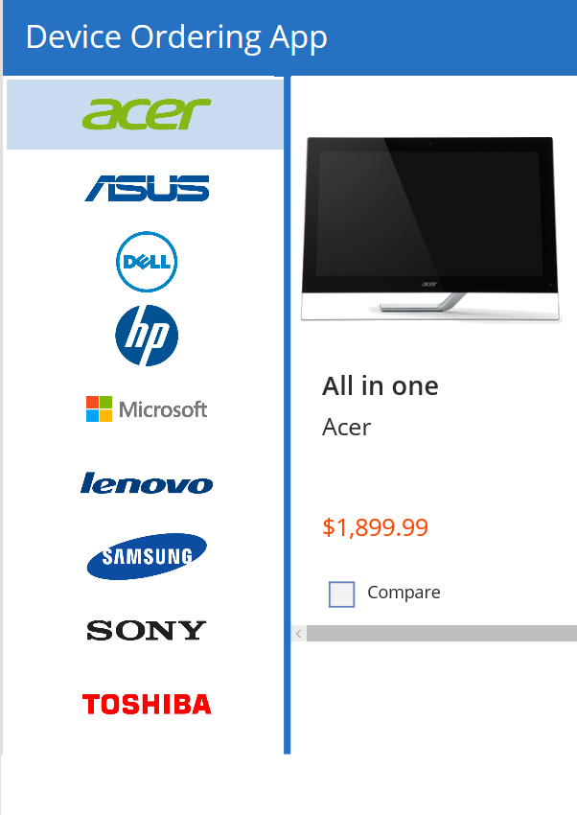
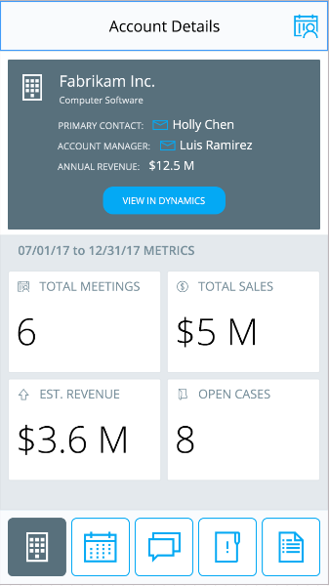

Power Apps: a low-code approach to building apps
Easily build apps with a full featured low-code / no-code platform
Connect to your existing data with 250+ pre-built connectors and custom connectors
Store your data in the Common Data Service
Integrated with Office 365, Azure, Dynamics 365, and Power BI
Strong enterprise governance & security
Pro-dev extensibility

Slide 14
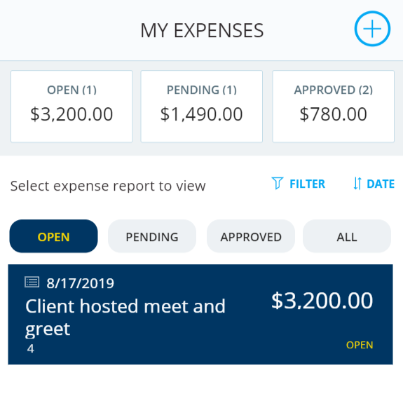
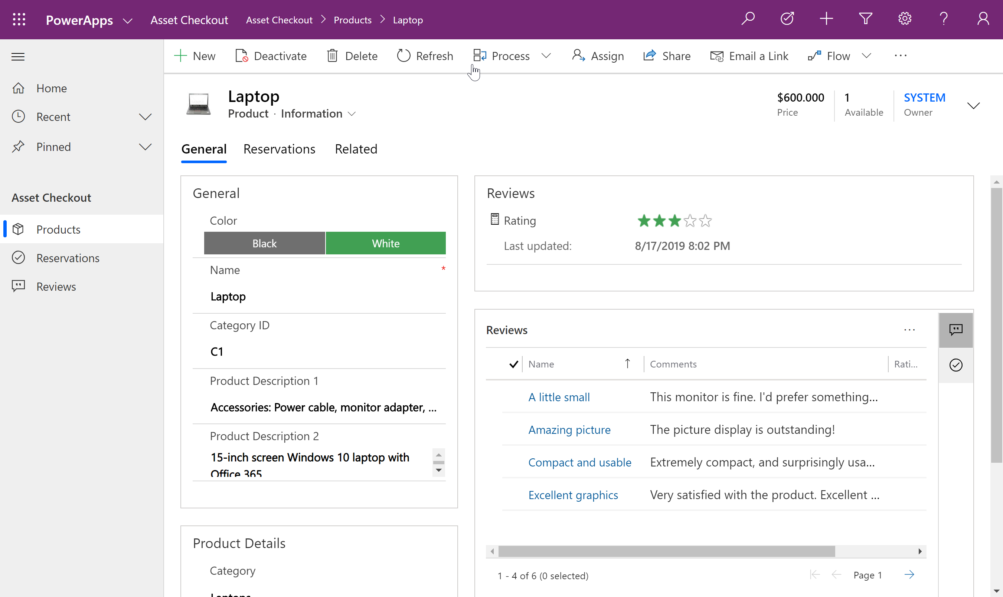
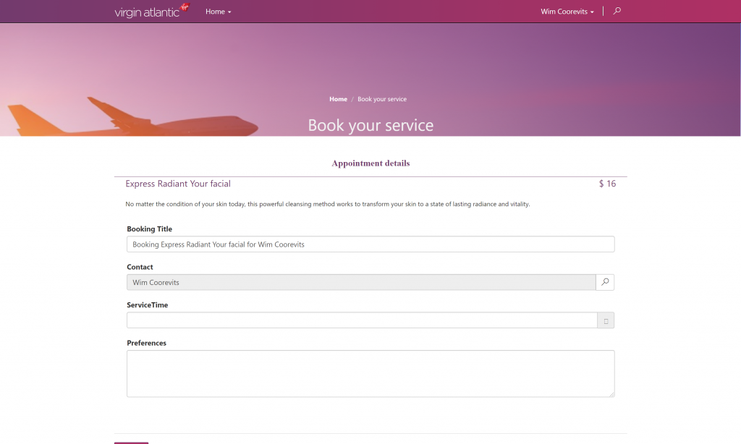
Types of Power Apps
Canvas Apps
Model Driven Apps
Portals

Slide 15

Canvas Apps

Slide 16
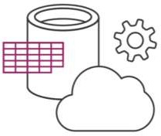
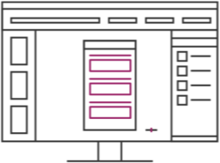
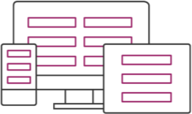
Canvas Apps help business-power-users to create and use custom business apps across platforms using Excel and PowerPoint skills
Connect to data & systems you’re already using easily
Create apps, forms, and workflows without writing code
Use apps on any device – both web and mobile

Slide 17
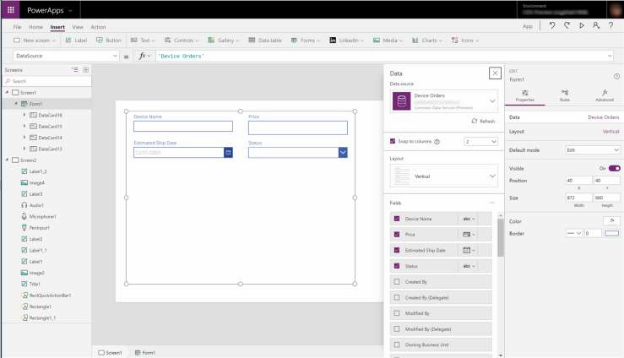
EASY AUTHORING
Truly WYSIWYG – full control over user experience, use it as you build it
Create app logic with familiar Excel-like expressions
Mash up data from multiple
sources right at the app level

Slide 18
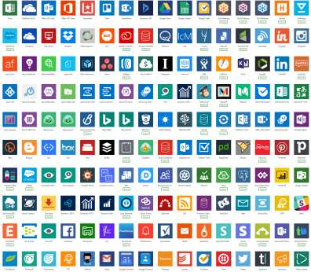
CLOUD AND ON-PREMISES CONNECTIVITY
Built-in connectivity to 200+ cloud services, files, databases, web APIs, etc.
Seamless hybrid connectivity to on- premises systems via the On- Premises Data Gateway
Build custom connectors for everyone to leverage

Slide 19
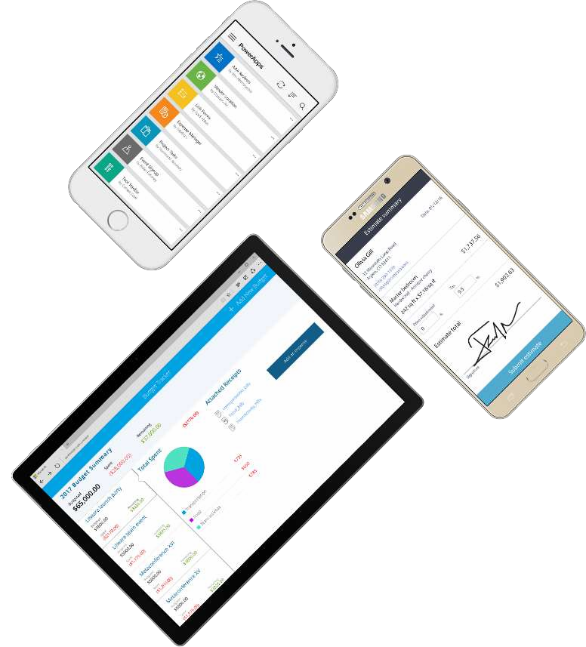
CROSS-PLATFORM
Publish instantly to iOS, Android,
Windows, and the web
Sharing apps is like sharing documents
Manage across environments

Slide 20

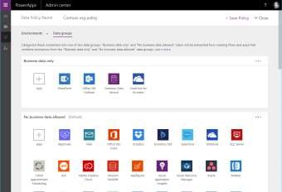
ENTERPRISE-GRADE MANAGEMENT AND CONTROL
All identity is managed through Azure Active Directory, enabling rich policies and multi- factor authentication
Admin Center providing full audit logs, usage analytics, data loss prevention, security and data management
Centrally manage all your apps, first and third party, deployed across your organization

Slide 21
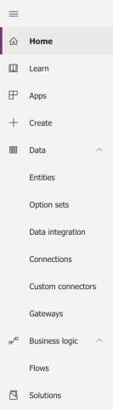
POWERAPPS MAKER PORTAL [HTTPS://WEB.POWERAPPS.COM/]
Home page for Makers
Learn
Guided learning, documentation, community, what’s new
Apps
View apps, open apps, create new apps, run sample apps, create apps from sample apps
Create
Create new apps from blank or from sample apps
Data
Manage Entities, option sets, data integration, connections, custom connections & gateways
Business Logic
Add Flows to your apps
Solutions
Create packages of PowerApps, Flows and CDS Entities (Solutions), distribute them to your customers or move them across environments

Slide 22
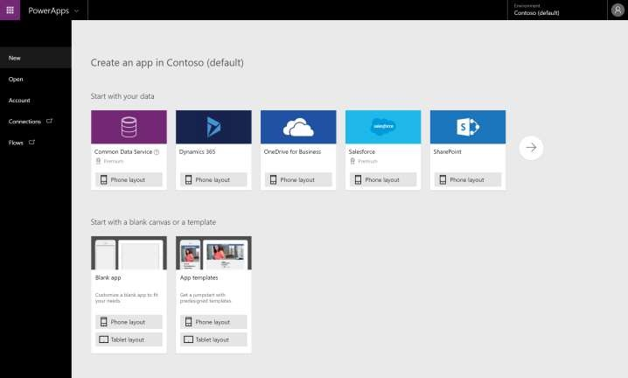
POWERAPPS STUDIO FOR THE WEB [HTTPS://CREATE.POWERAPPS.COM/]
Canvas apps authoring experience
Start with your data
Start with a blank canvas
Start with a template

Slide 23
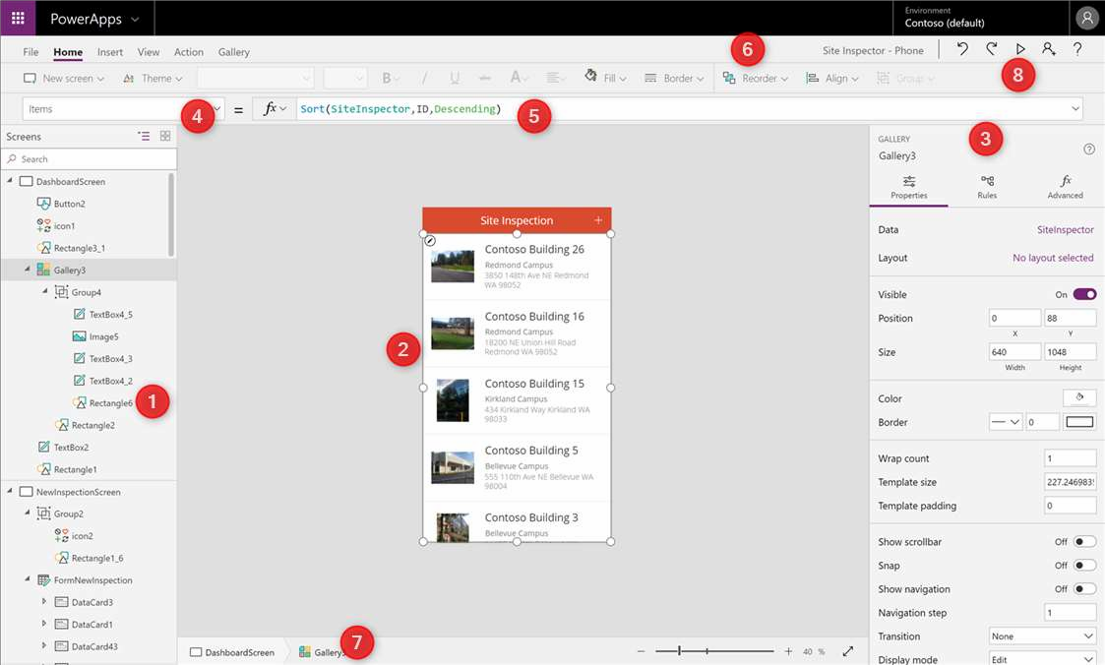
POWERAPPS STUDIO PARTS
Left Navigation bar
Middle pane (current screen)
Right hand pane
Property Pane
Formula bar
Ribbon
Bread crumb navigation
Preview button (F5)

Slide 24

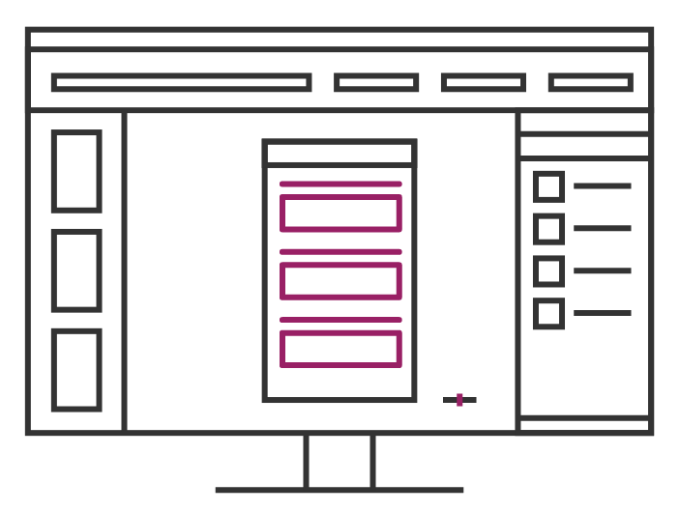
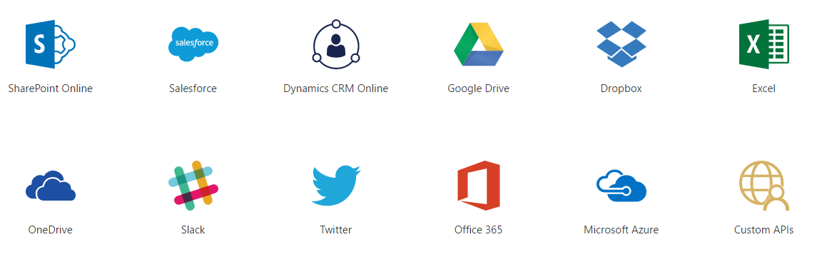
Data Sources and connections

Slide 25
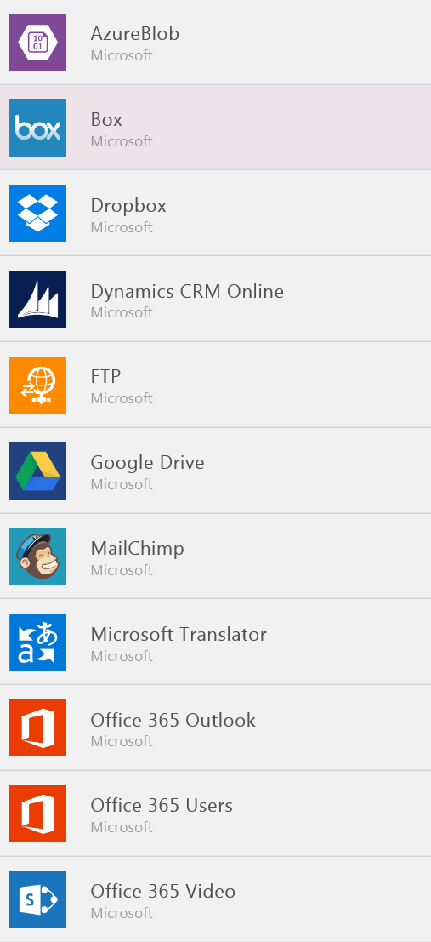
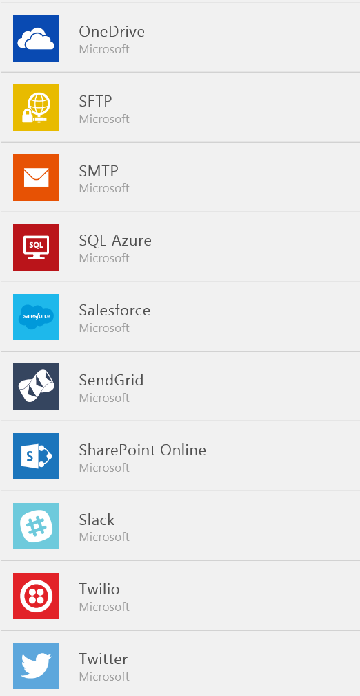
Data Sources…
SaaS Data Sources
Excel on OneDrive
Excel on Dropbox
Excel on Google Drive
Office 365
SharePoint Online Lists
Google Sheets
Sales force
Dynamics CRM

Slide 26
Demo
Create the records in Dynamics CRM with the blank canvas app using Patch function

